Slide 1
DATA ANALYSIS AND PROGRAMMING WITH PYTHON
Lecture 3
Data preparation and visualization in Python
26 November 2023

Slide 2
Lecture plan
Working with data in Python
Data preparation
Pandas
Pandas vs SQL
Data visualization
Matplotlib
Seaborn
Plotly
Practice in Jupyter Notebook

Slide 3

Data Preparation
Pandas
Pandas is a Python library used for working with data sets.
It has functions for
analyzing,
cleaning,
exploring,
and manipulating data.
The name "Pandas" has a reference to both "Panel Data", and "Python Data Analysis" and was created by Wes McKinney in 2008.

Slide 4
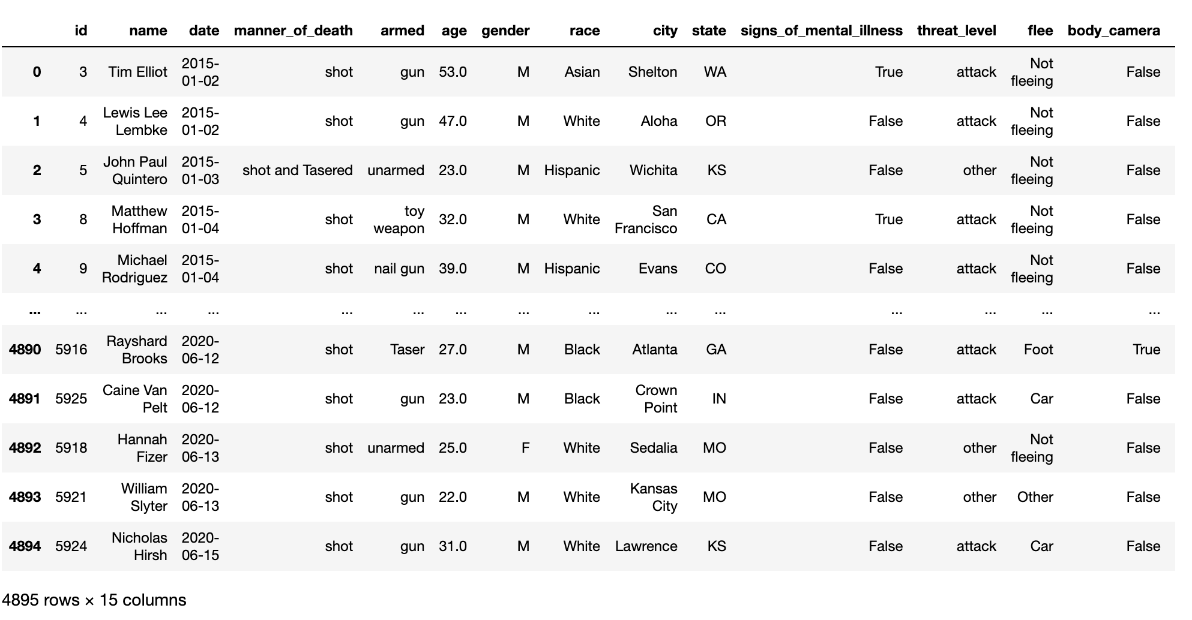
Data Preparation
Pandas DataFrame

Slide 5
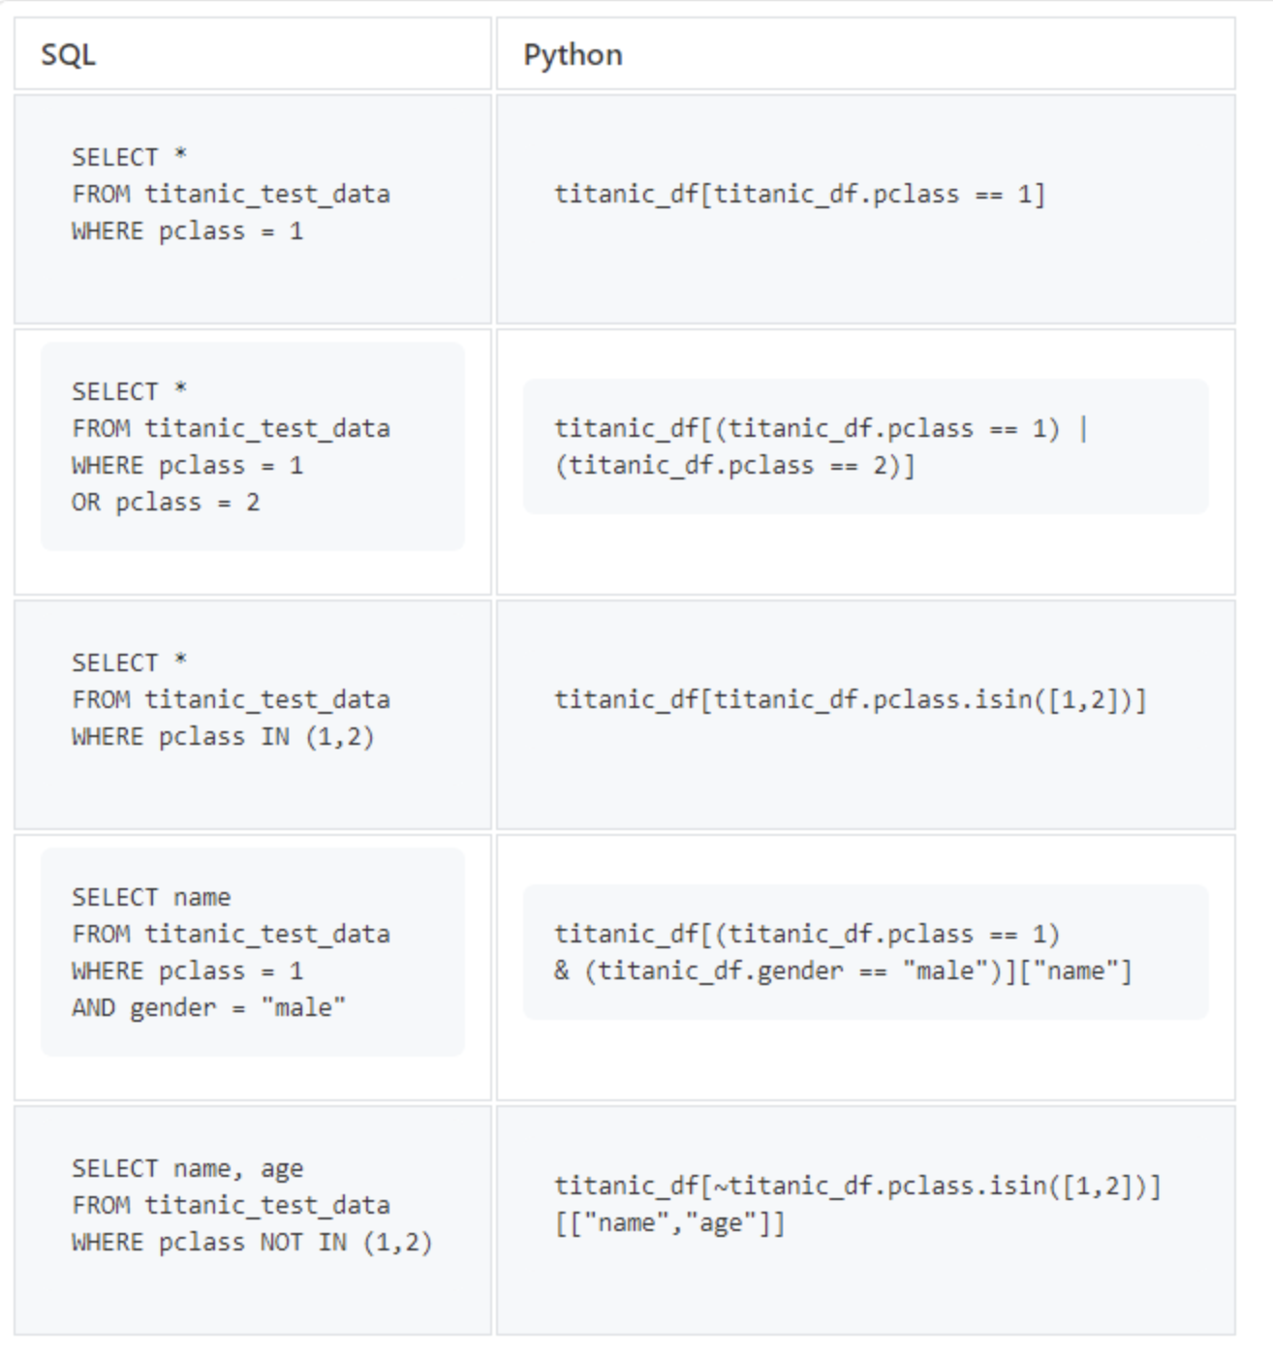
Data Preparation
Pandas vs SQL
Pandas and SQL are both used for selecting filtering and grouping data.
While Pandas has more functionality, SQL performs better on large data sets.
As a part of Python - pandas is very convenient when you need not only extract data, but analyze it.

Slide 6
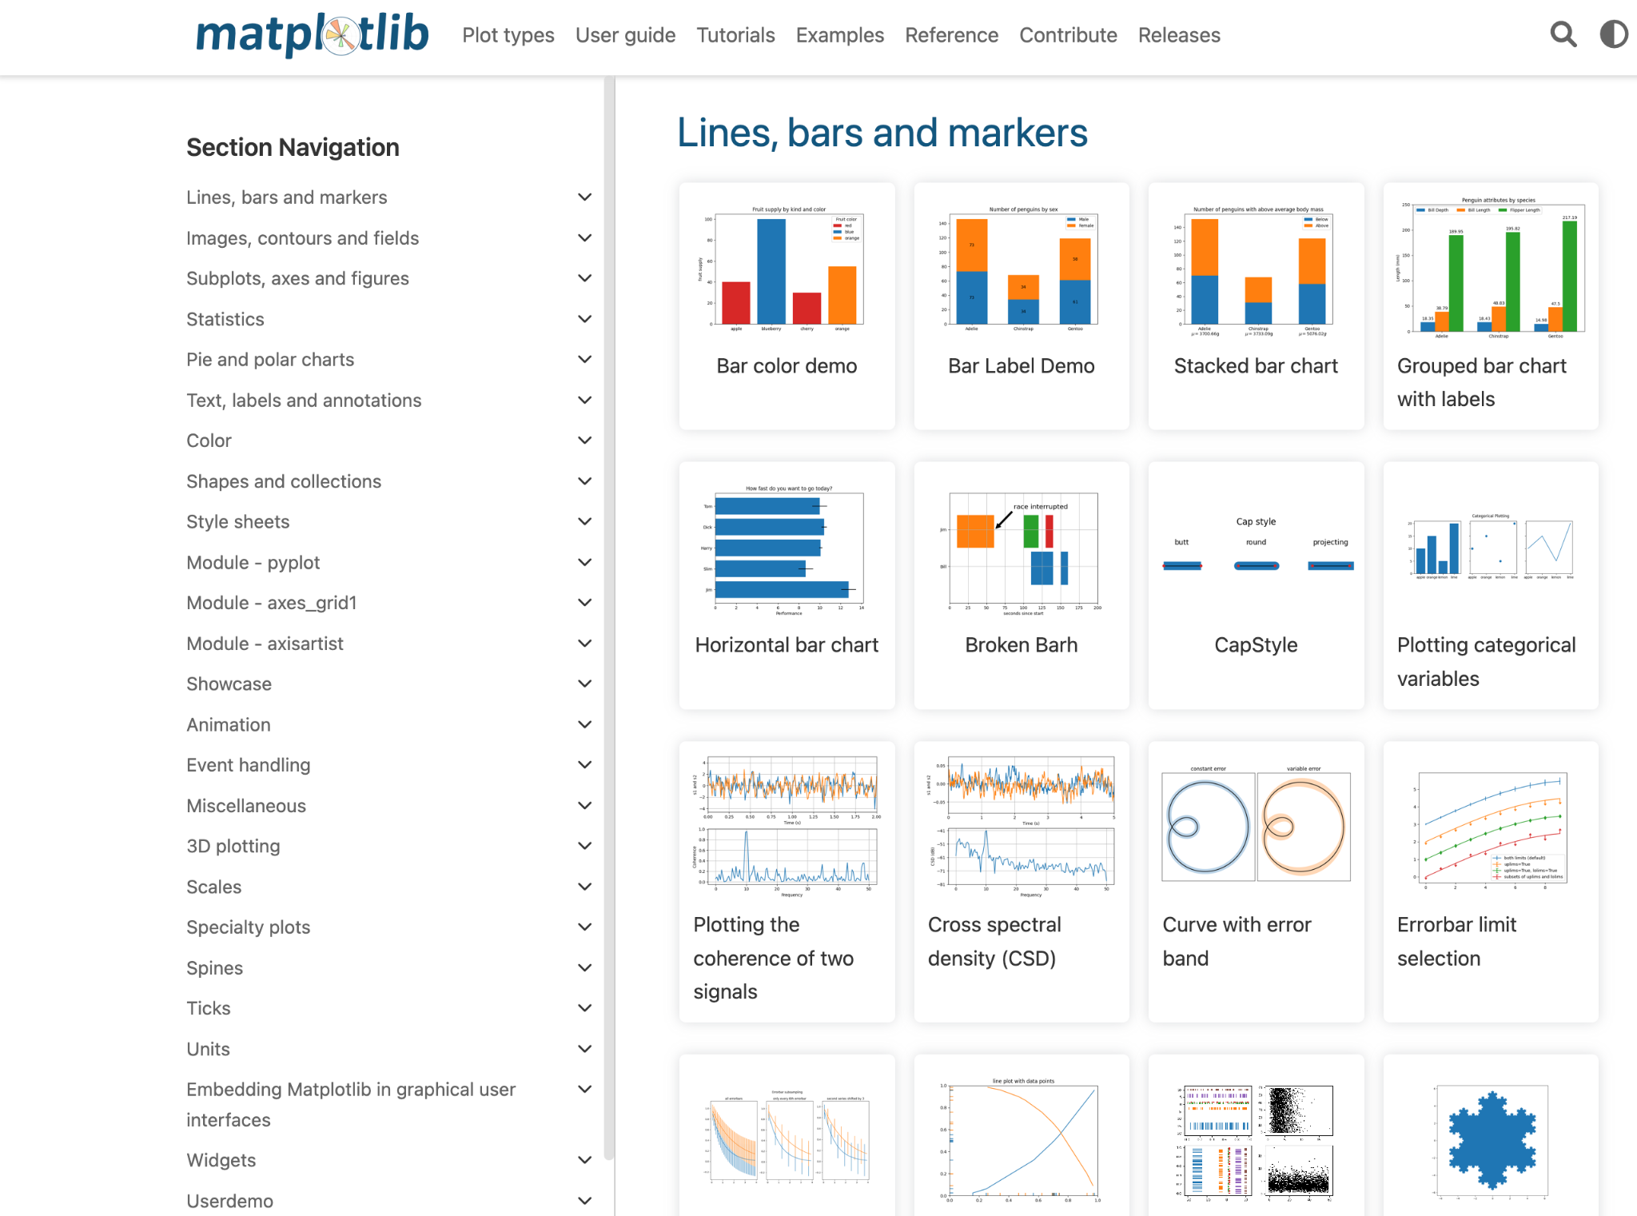
Data Visualization
Matplotlib
Matplotlib is the most common visualization tool. It perfectly balances simplicity and functionality and has lots of patterns.

Slide 7
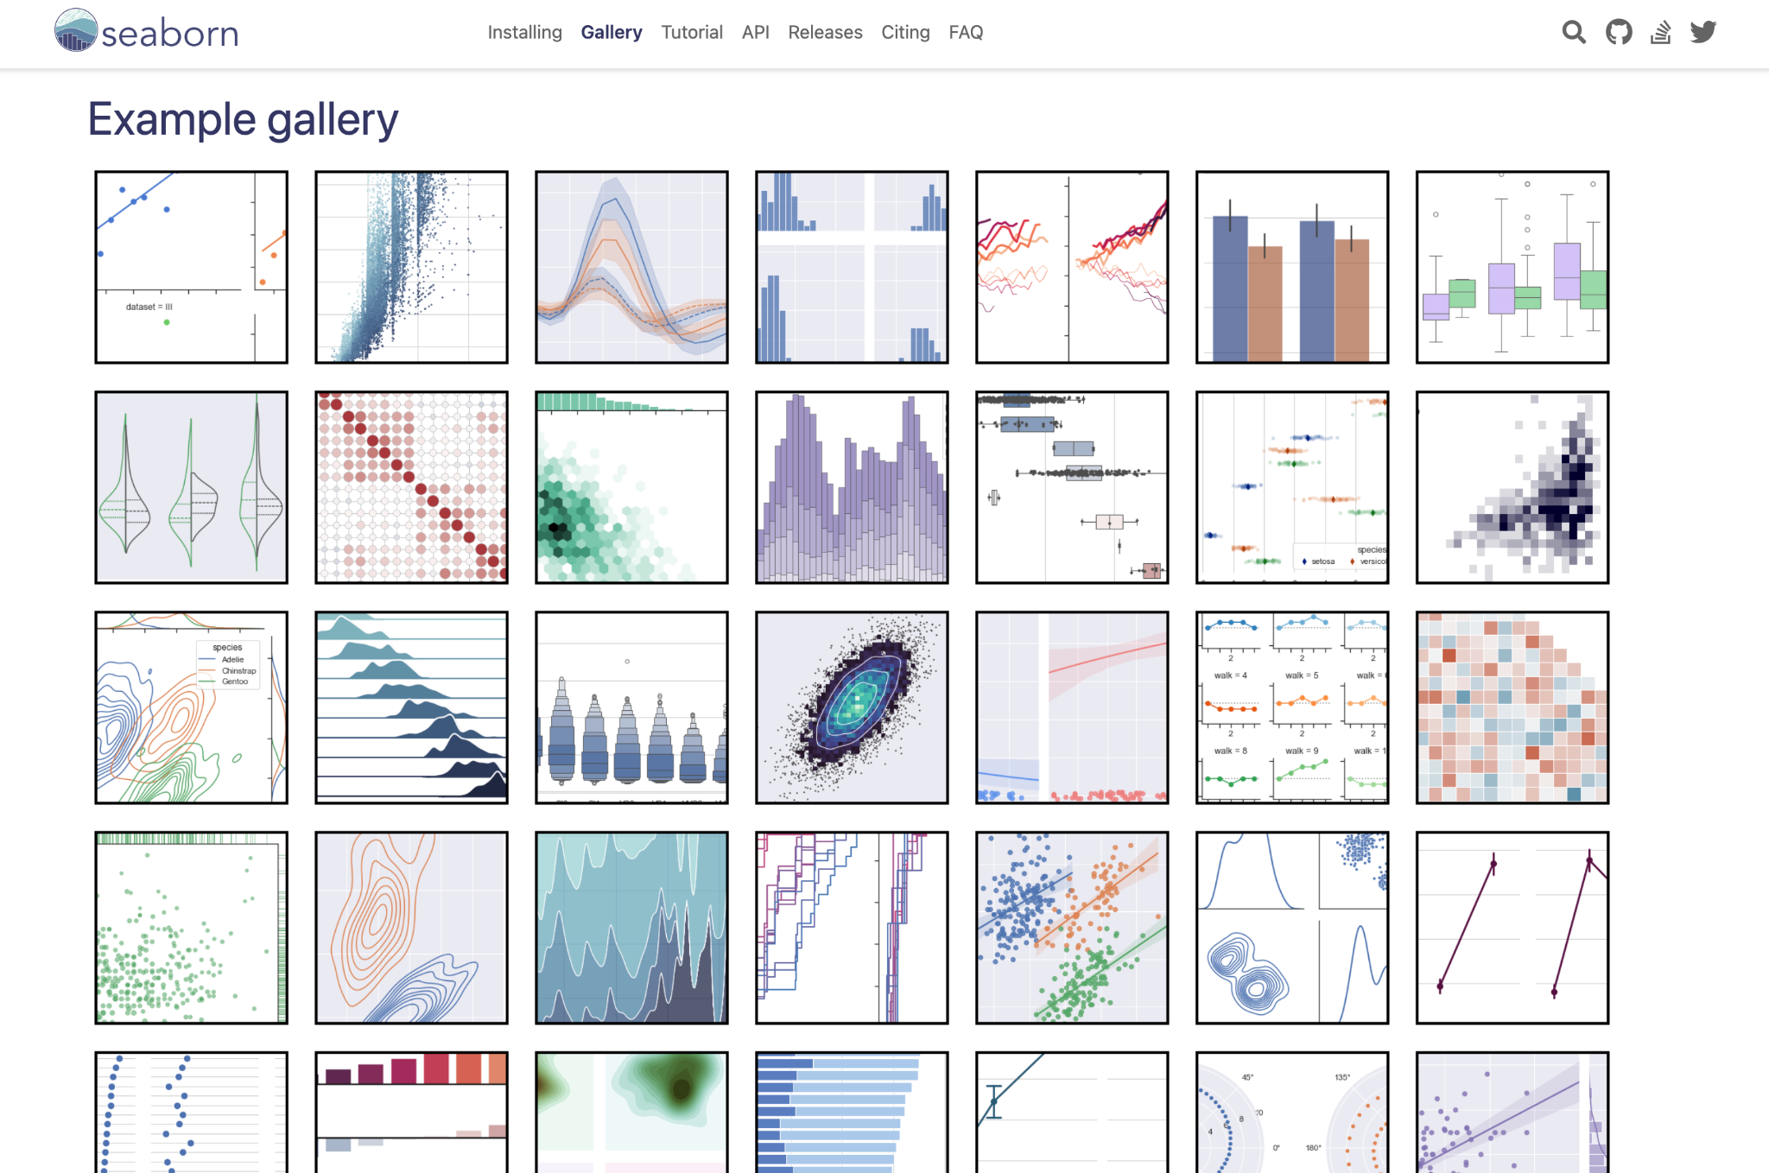
Data Visualization
Seaborn
Seaborn is an advanced statistical visualization tool. It has lot’s of ready made visualizations in it’s gallery that you can reuse for your research.

Slide 8
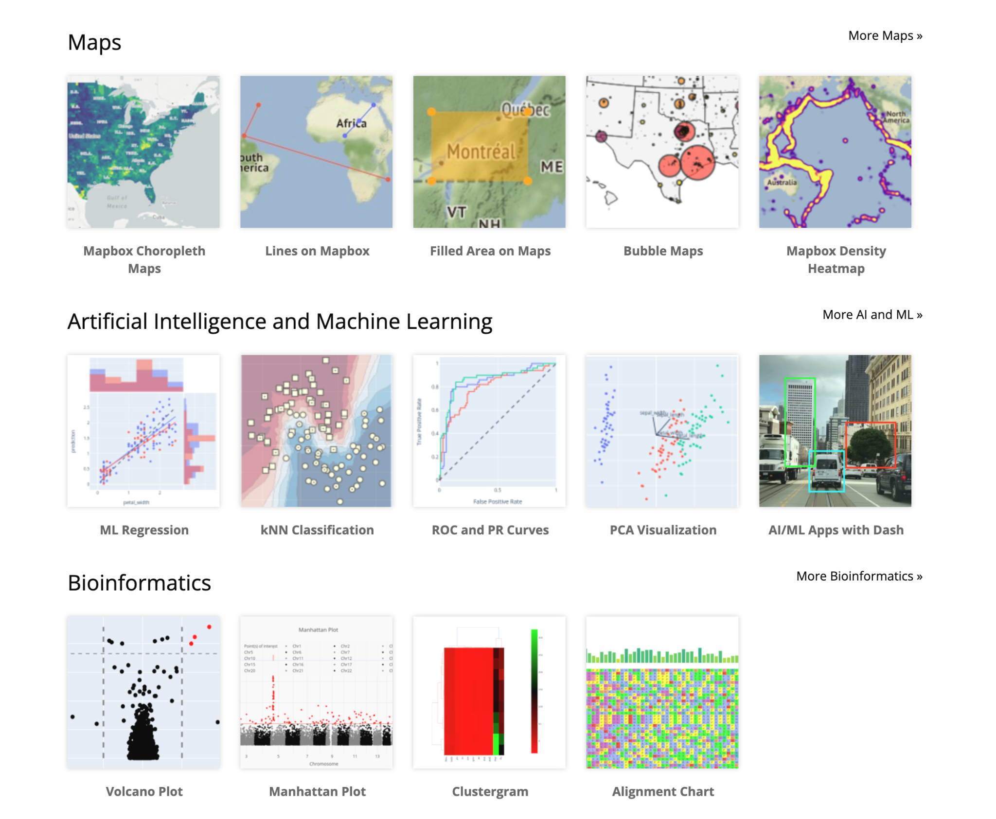
Data Visualization
Plotly
Plotly is the most functional library and it’s more dashboard based tool. It is very useful when you want to monitor the same data over time.

Slide 9
Practice in Jupyter Notebook
Let’s practice in Jupyter Notebook!

